Slide 1
TIME
MANAGEMENT
HABITS OF
HIGH ACHIEVERS
JULIE YOUNKIN
LEADERSHIP DEVELOPMENT
CONSULTANT

Slide 2
SINGLE TASKING
MANAGING INTERRUPTIONS
BLOCK SCHEDULING
ENERGY CLOCK
BETTER MEETINGS

Slide 3
The Benefits of Single Tasking
SINGLE TASKING
Single Tasking is the practice of doing one activity at a time with no interruptions until the task is complete or a significant time has elapsed.

Slide 4
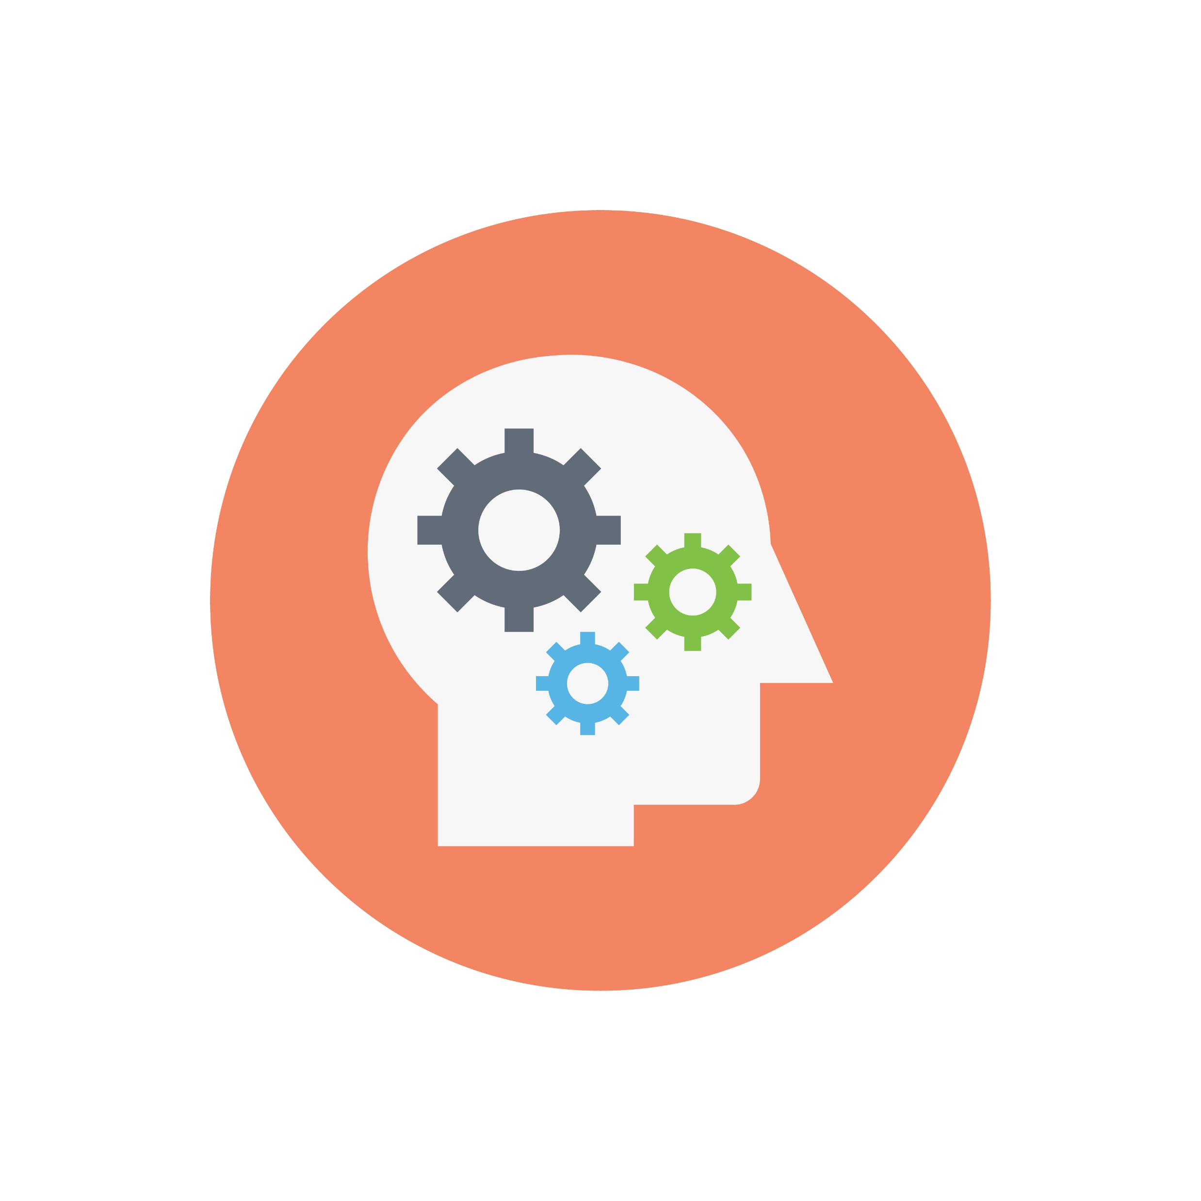
The Benefits of Single Tasking
SINGLE TASKING
1
Improves Productivity
2
Increases Commitment
3
Increases Self-Discipline

Slide 5
A three-second distraction leads to double the mistakes
Researchers tested 300 Michigan State students on their ability to persevere through interruptions while taking a computer test.
With a 2.8-second interruption, the students made double the errors when they returned to the test. With a 4.4-second interruption, the error rate quadrupled.

Slide 6
Multitasking divides your attention from 100 percent to different portions, so a smaller amount is applied to each task.
You ultimately are never giving 100 percent focus and attention to anything.
Dr. Theo Tsaousides

Slide 7
Single-tasking
PRACTICE SINGLE-TASKING
Work on a task or project uninterrupted for 25 minutes.
Turn off anything that rings/buzzes (phone, email, text)
If you have to – communicate with those that need to know.
Don’t check your inbox.
Manage interruptions so they are little to none.
Make a promise to yourself that you will not interrupt yourself.
Now, immerse yourself in the task.

Slide 8
The Pomodoro Technique
The Pomodoro Technique is a simple
productivity method to
enter a stage of hyper-focus.

Slide 9
Managing Interruptions
Productivity Killers
Over-checking email. On average, office workers check their email 15 times per day, or every 37 minutes.
Answering every call (even if you don’t have to). Taking every personal and business call instead of allowing voicemail to occasionally do it’s job.
Accepting all live interruptions. Stopping what you’re doing to help a co-worker or chat about something that can be handled later.
React to most notifications (email and phone: app notifications)
Stopping and starting on several tasks before finishing any of them.
Becoming easily distracted by activity around you.
1 = Never
2 = Seldom
3 = Sometimes
4 = Usually
5 = Always

Slide 10
Managing Interruptions
DECREASE INTERRUPTIONS
THROUGH EFFECTIVE COMMUNICATIONS
Plan and communicate your objective with co-workers and manager.
Trade ‘focus time’ / ‘deep work’ with others.

Slide 11
Managing Interruptions
DECREASE INTERRUPTIONS
THROUGH EFFECTIVE COMMUNICATIONS
THE ‘POP-IN’ INTERRUPTIONS
Inform the other party you’re trying not to break focus.
Negotiate a time when you can get back to them about the issue.
Follow Up with the other party when you promised.

Slide 12
Block Scheduling
MANAGE YOUR TIME – MANAGE YOUR LIFE
Block scheduling is assigning time slots to your calendar and defending those scheduled times to get more done.

Slide 13
A Holistic Approach to Managing Time
BLOCK SCHEDULING is thoughtfully planning and preparing for:
Task time
Work time
Planning/prep time
Research time
Meetings

Slide 14
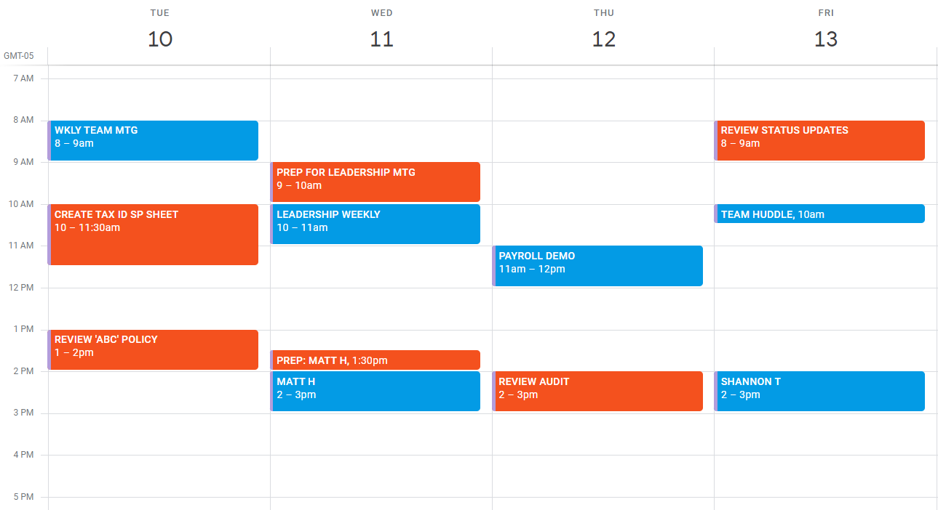
Block Scheduling

Slide 15
Block Scheduling
BLOCK SCHEDULING PRO TIP
SCHEDULE TOUGHEST
ITEMS EARLY

Slide 16
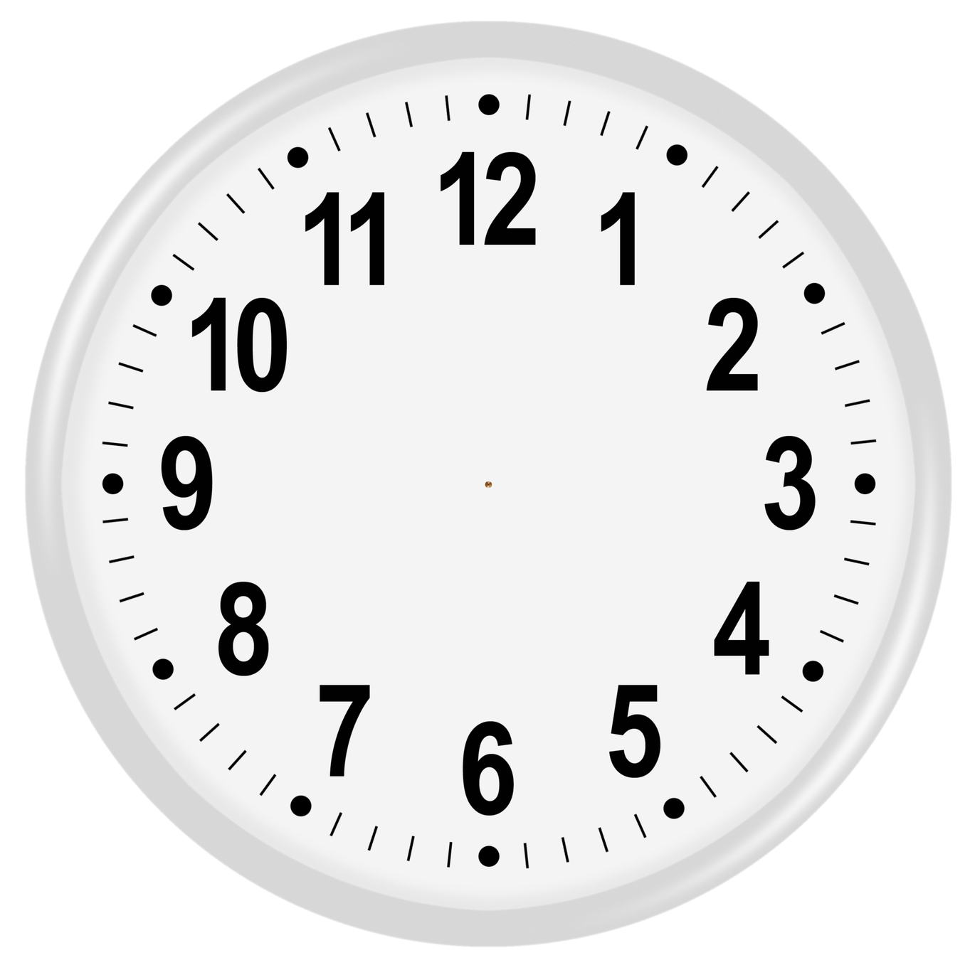
My Energy Clock
Alert/Focused
Cruise Control
Distracted
Slower
1
Distracted
2
Alert/Focused
Slower
3
4

Slide 17
6 REASONS PEOPLE HATE MEETINGS
1) There is no agenda. If there is one, people are allowed to
go off track.
2) You don’t start and end on time.
3) Participants are not prepared.
4) Participants are not held accountable (Who’s doing what?)
5) The length of the meeting is wrong.
6) Status updates are inconsistent.

Slide 18
STANDARDIZE THE ‘STATUS UPDATE’
What have I accomplished
What challenges am I facing
How am I overcoming them
I am expecting to accomplish __________
by ______________.

Slide 19
SINGLE TASKING
MANAGING INTERRUPTIONS
BLOCK SCHEDULING
ENERGY CLOCK
BETTER MEETINGS

Slide 20
THANK
YOU!
JULIE YOUNKIN
LEADERSHIP DEVELOPMENT
CONSULTANT

