Slide 1
SODAK SHRM
DECODING
EMOTIONAL
INTELLIGENCE
JULIE YOUNKIN

Slide 2
10,000
PEOPLE

Slide 3
INFLUENCE
The capacity to have an impact on the behaviors, attitudes and choices of others.

Slide 4
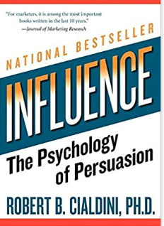

Slide 5
WARMTH
CHARISMA
COMPETENCE
likability

Slide 6
Before people decide what
they think of your message
they decide what they
think of you.

Slide 7
Develop genuine curiosity
Become a great listener
Demonstrate empathy
Love people

Slide 8
#1
BE CURIOUS

Slide 9
ASKING GENUINE QUESTIONS
INCREASES LIKABILITY
The Journal of Social Psychology

Slide 10
7.0
6.5
6.0
5.5
5.0
4.5
4.0
Agreed to Second Date
Two or less
Follow-Up Questions
Four+
Follow-Up
Questions

Slide 11
#2
BE A BETTER LISTENER

Slide 13
HABIT #5
SEEK
FIRST TO
UNDERSTAND
THEN
TO BE
UNDERSTOOD

Slide 14
INTERNAL PRE-OCCUPATION
we speak 200 wpm
but we can hear 400 wpm

Slide 15
SELF
INVOLVEMENT

Slide 16
CONVERSATION NARCISSIST

Slide 17
EMOTIONAL
INTELLIGENCE
DECODED:
READ THE ROOM

Slide 18
#3
EMPATHY

Slide 19
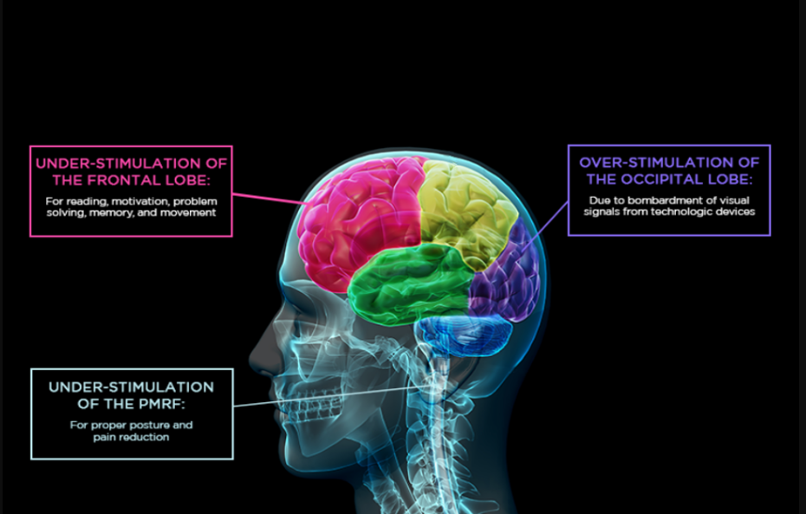
DIGITAL DIMENTIA

Slide 20
INCREASE YOUR EQ
Develop genuine curiosity
Become a great listener
Demonstrate empathy
Love people

Slide 21
IF YOU CAN
UNDERSTAND
PEOPLE
YOU WILL
INCREASE
EQ

Slide 22
LOGICAL
ANALYTICAL
DRIVER
INTROVERT
EXTROVERT
AMIABLE
ENTHUSIAST
EMOTIONAL

