Slide 1
Big League Talent Development
On a Sandlot Budget
Jon Swartzentruber, Managing Partner
Paradyne Consulting Works LLC

Slide 2
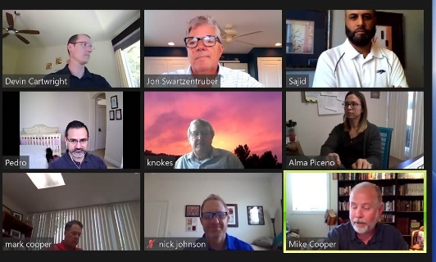
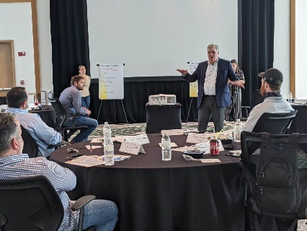
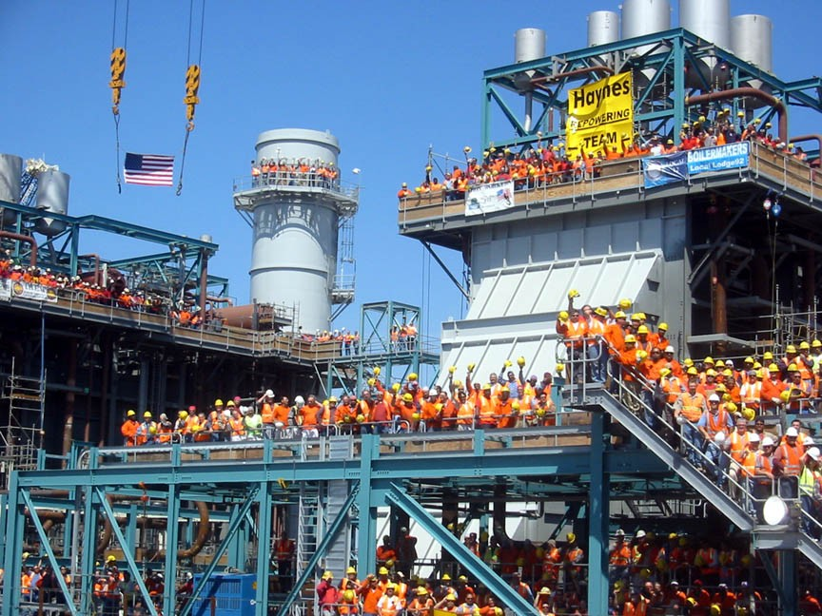
2017 – Present Managing Partner, Paradyne Consulting Works
2006 – 2017 VP, Leadership Development, Kiewit Corporation

Slide 3
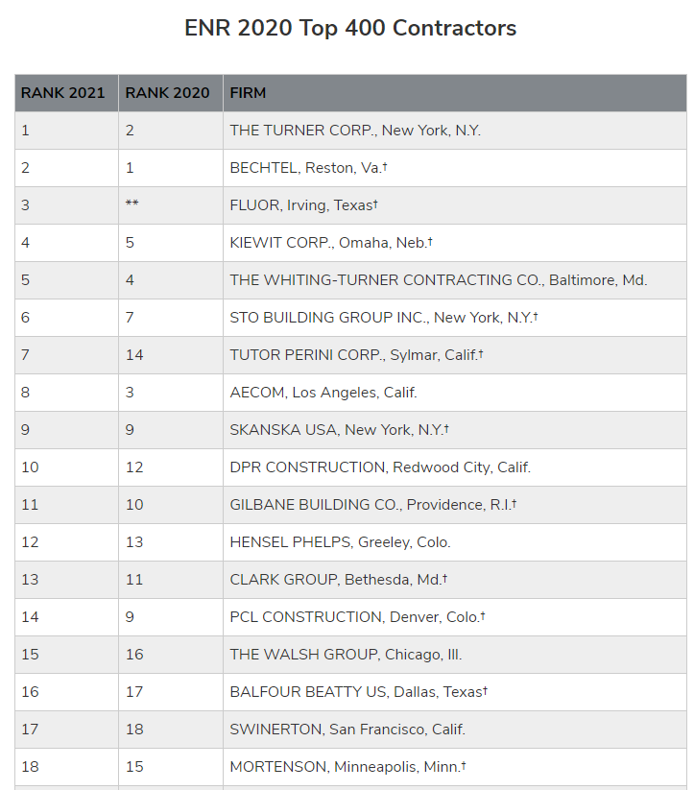


Slide 4
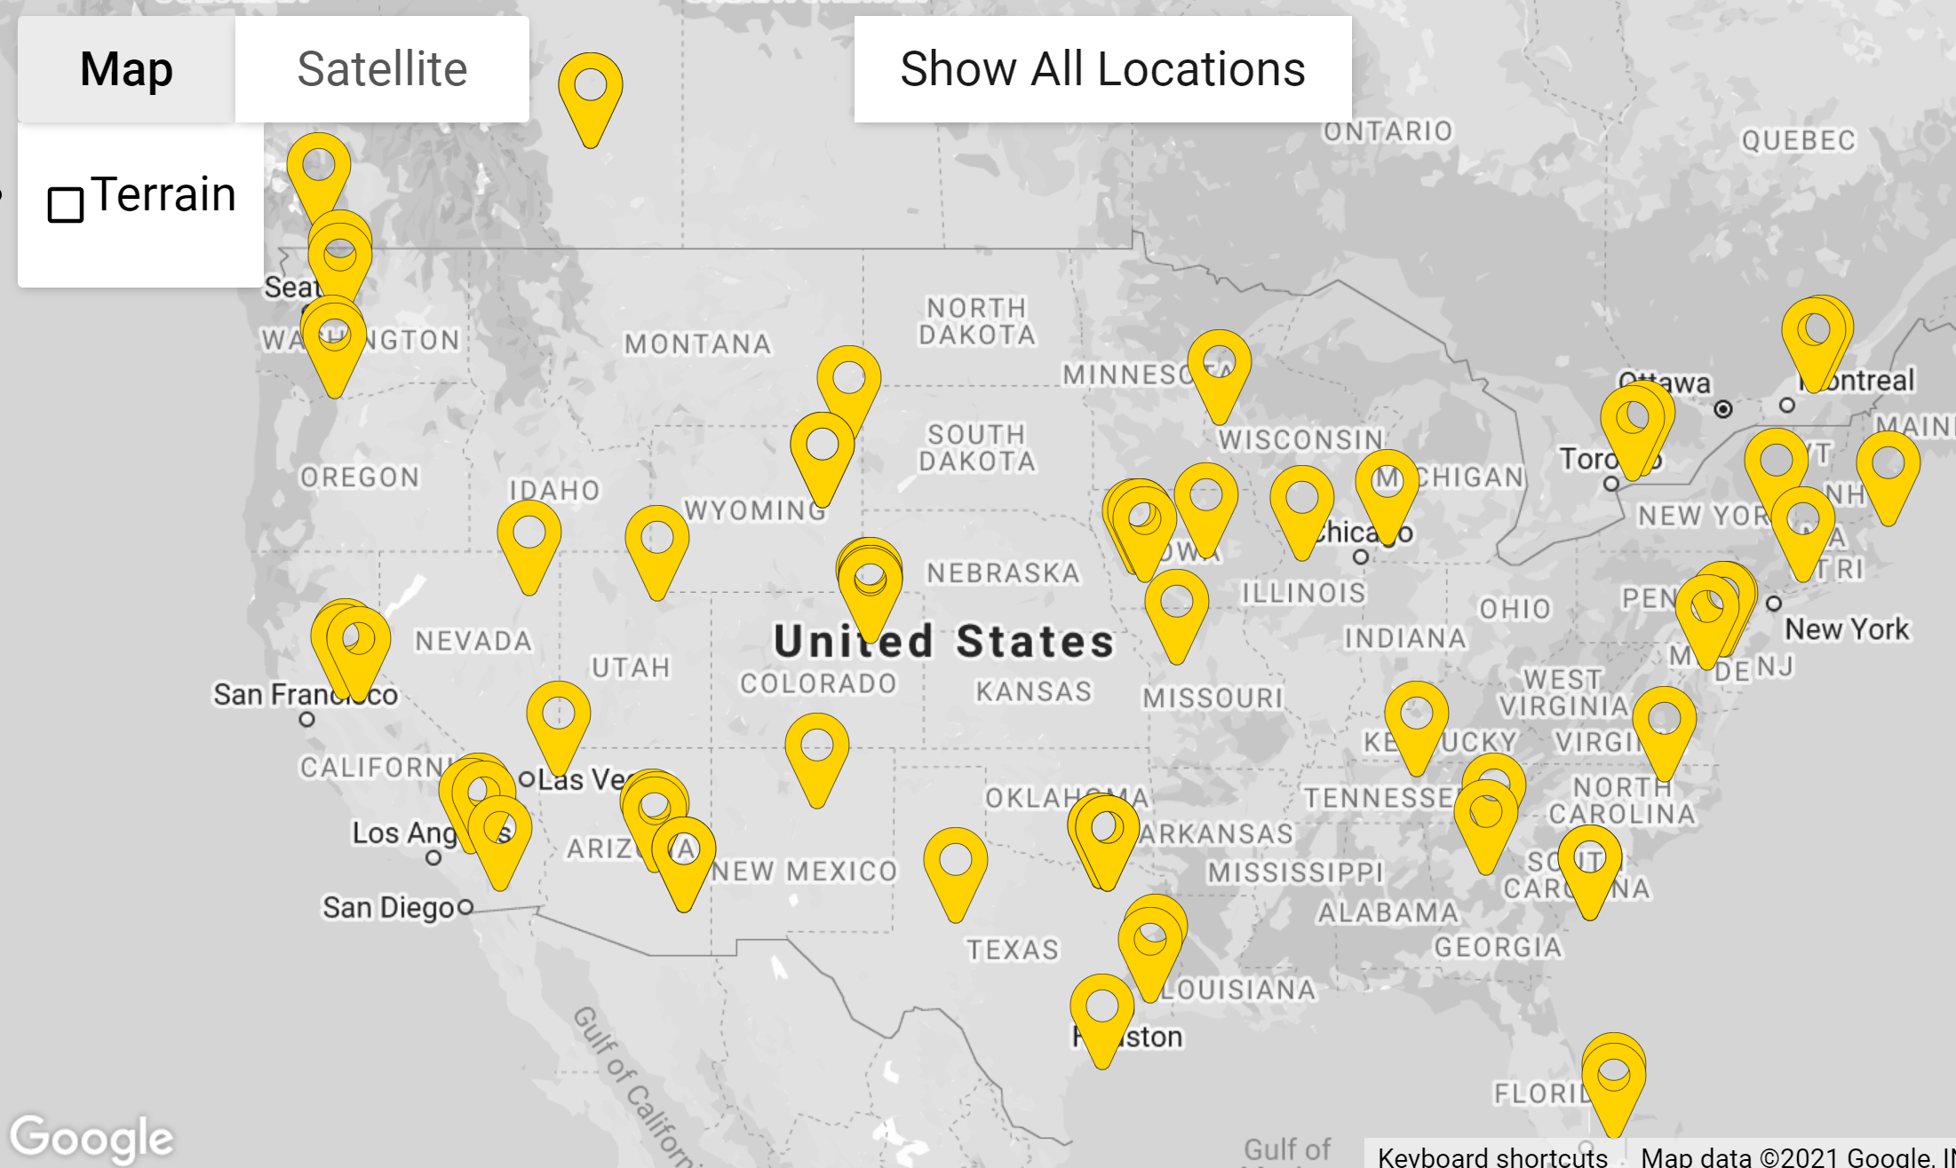

Slide 5
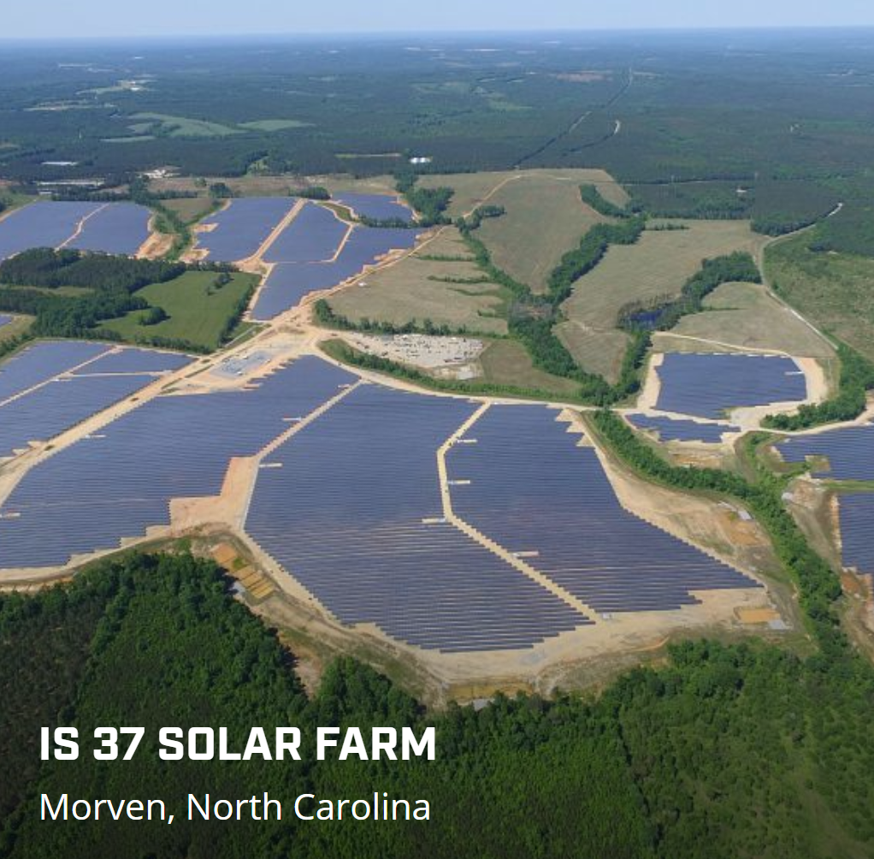




Slide 6
2007 - Revenue Growth ($B)

Slide 7
2007 - Revenue Forecast ($B)

Slide 8
2007 - People Growth

Slide 9
2007 - People Forecast

Slide 10
2002
2006
2007
Experience Distribution - 2007
Headcount
# Years with Company
10

Slide 11
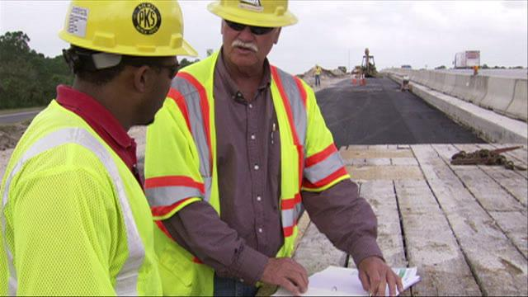
Challenge #1
Leadership - noun (n): Insure we have the men and women needed to run the business

Slide 12
Leadership Needs Forecast- 2007
Position | 2007 | 2012
 | Total Now
Division Managers | 8
District Managers | 20
Area Managers | 65
Sponsors | 104
Project Managers | 188
Project Engineers | 220

Slide 13
Leadership Needs Forecast- 2007
Position | 2007 | 2012
 | Total Now | Retirements
Division Managers | 8 | 3
District Managers | 20 | 6
Area Managers | 65 | 4
Sponsors | 104 | 0
Project Managers | 188 | 0
Project Engineers | 220 | 0

Slide 14
Leadership Needs Forecast- 2007
Position | 2007 | 2012
 | Total Now | Retirements | Added for Growth
Division Managers | 8 | 3 | 6
District Managers | 20 | 6 | 15
Area Managers | 65 | 4 | 40
Sponsors | 104 | 0 | 80
Project Managers | 188 | 0 | 150
Project Engineers | 220 | 0 | 200

Slide 15
Leadership Needs Forecast- 2007
Position | 2007 | 2012
 | Total Now | Retirements | Added for Growth | Advanced to fill vacancies above
Division Managers | 8 | 3 | 6
District Managers | 20 | 6 | 15 | 9
Area Managers | 65 | 4 | 40 | 21
Sponsors | 104 | 0 | 80 | 44
Project Managers | 188 | 0 | 150 | 80
Project Engineers | 220 | 0 | 200 | 150

Slide 16
Leadership Needs Forecast- 2007
Position | 2007 | 2012
 | Total Now | Retirements | Added for Growth | Advanced to fill vacancies above | Total New Needed
Division Managers | 8 | 3 | 6 |  | 9
District Managers | 20 | 6 | 15 | 9 | 30
Area Managers | 65 | 4 | 40 | 21 | 65
Sponsors | 104 | 0 | 80 | 44 | 124
Project Managers | 188 | 0 | 150 | 80 | 230
Project Engineers | 220 | 0 | 200 | 150 | 350

Slide 17
2002
2006
2007
Where will they come from?
Total new
needed in 5 yrs
Headcount
Project Managers | 230
Average time to advance = 14 yrs.
# Years with Company

Slide 18
Attrition in 2007

Slide 19

Challenge #2
Leadership - verb (v): How leaders act. Do they exhibit the skills to:
Create engagement
Retain employees
Get things done

Slide 20
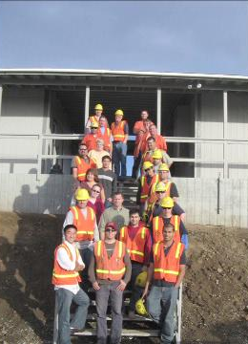
Our Organizational Development Mission in 2007:
Develop leaders faster
Develop better leaders

Slide 21

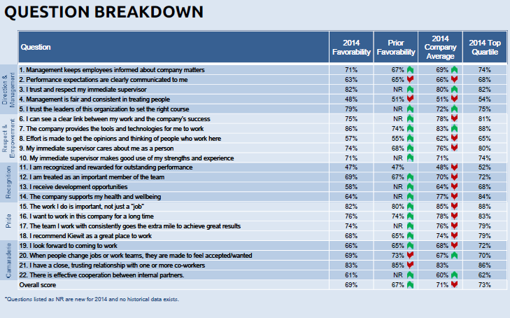
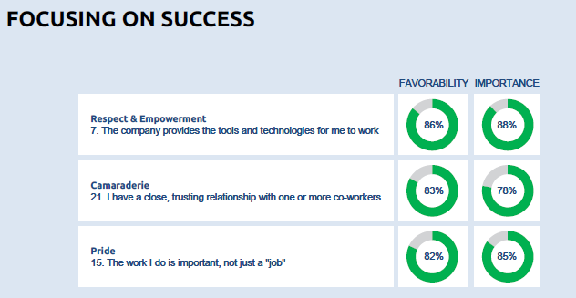
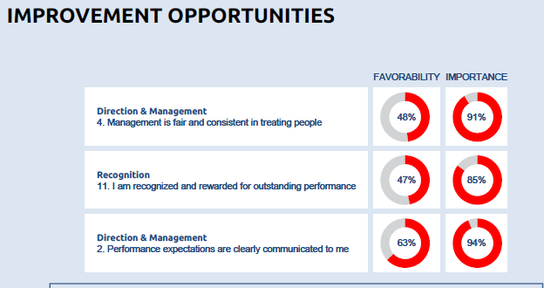
K-22 Engagement Survey

Slide 22
Our Talent Development Mission:
Develop leaders faster
Develop better leaders

Slide 23
Dist/Div Manager Area Manager Mega Project Director BD Exec
Leader of an Organization
Project Manager Sponsor Dept. Mgr.
Leader of Teams
Job Supt, Supt Project Eng Area Safety Mgr Sr. Bus.Mgr
Leader of Others
Estimator, Entry-level Business Manager etc.
Individual Contributor

Slide 24
Leadership Needs Forecast- 2007
Position | 2007 | 2012
 | Total Now | Retirements | Added for Growth | Advanced to fill vacancies above | Total New Needed
Division Managers | 8 | 3 | 6 |  | 9
District Managers | 20 | 6 | 15 | 9 | 30
Area Managers | 65 | 4 | 40 | 21 | 65
Sponsors | 104 | 0 | 80 | 44 | 124
Project Managers | 188 | 0 | 150 | 80 | 230
Project Engineers | 220 | 0 | 200 | 150 | 350

Slide 25
Identify and accelerate your high potentials
Dist/Div Manager Area Manager Mega Project Director BD Exec
Leader of an Organization
Project Manager Sponsor Dept. Mgr.
Leader of Teams
Job Supt, Supt Project Eng Area Safety Mgr Sr. Bus.Mgr
Leader of Others
Estimator, Entry-level Business Manager etc.
Individual Contributor

Slide 26

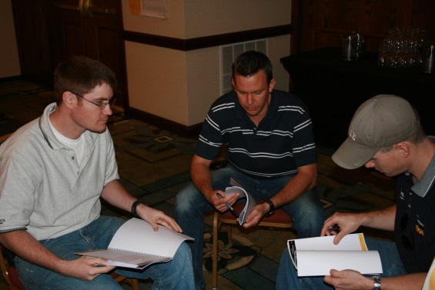
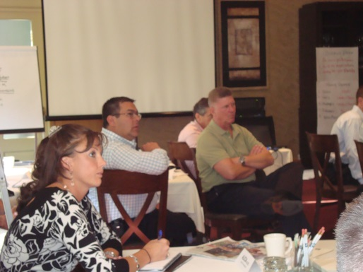
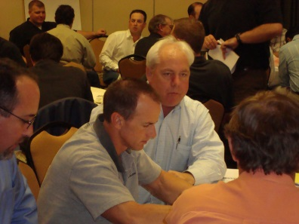

Slide 27
Dist/Div Manager Area Manager Mega Project Director BD Exec
Leader of an Organization
Hi Po
Project Manager Sponsor Dept. Mgr.
Leader of Teams
Leadership Succession Program
LSP
Job Supt, Supt Project Eng Area Safety Mgr Sr. Bus.Mgr
Leader of Others
Estimator, Entry-level Business Manager etc.
Individual Contributor

Slide 28

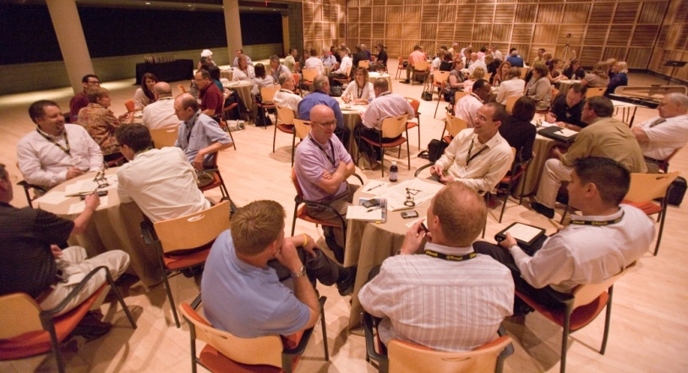
Dist/Div Manager Area Manager Mega Project Director BD Exec
Leader of an Organization
Hi Po
Project Manager Sponsor Dept. Mgr.
Leader of Teams
Leadership Succession Program
LSP
Job Supt, Supt Project Eng Area Safety Mgr Sr. Bus.Mgr
Leader of Others
Estimator, Entry-level Business Manager etc.
Individual Contributor

Slide 29
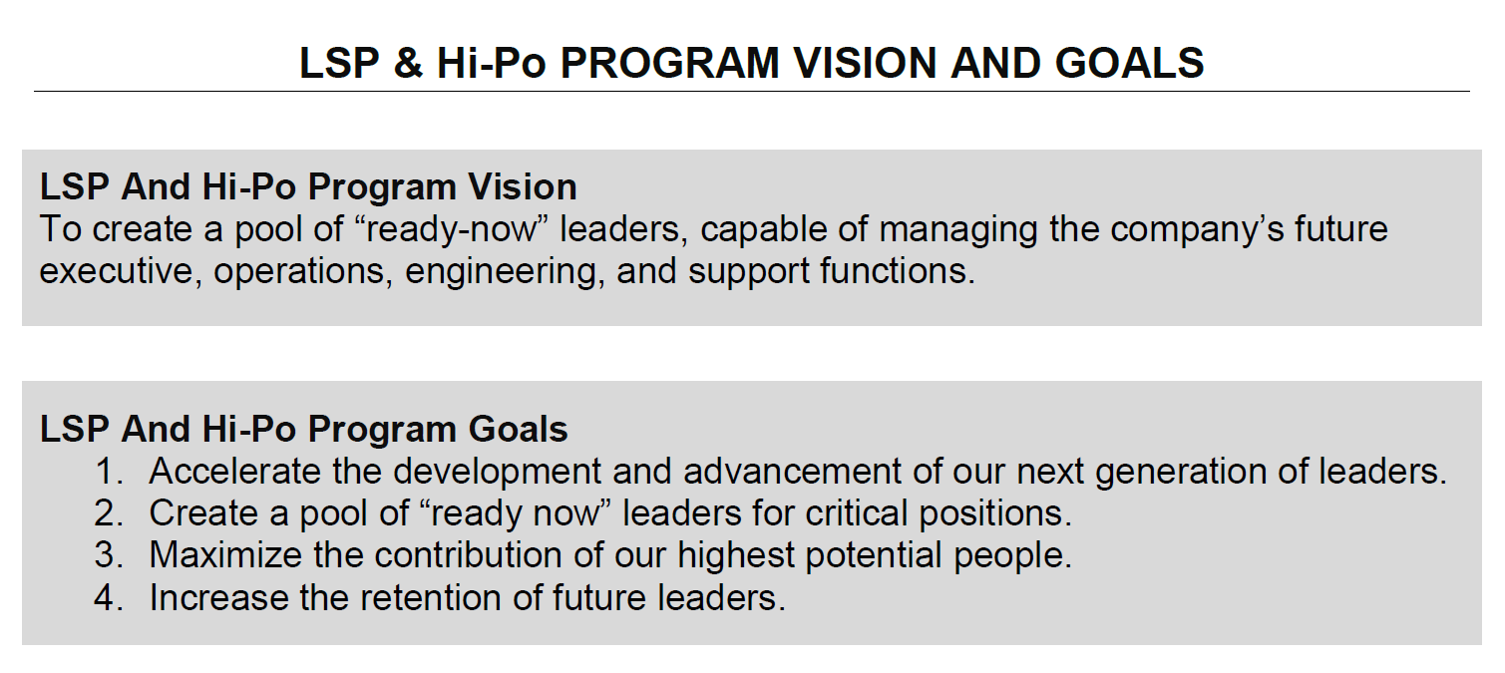

Slide 30
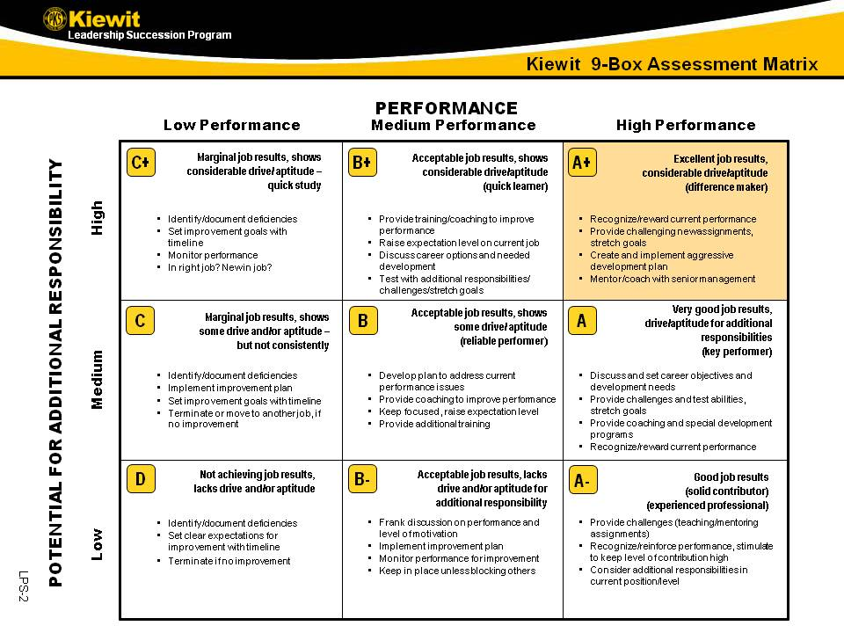

Slide 32
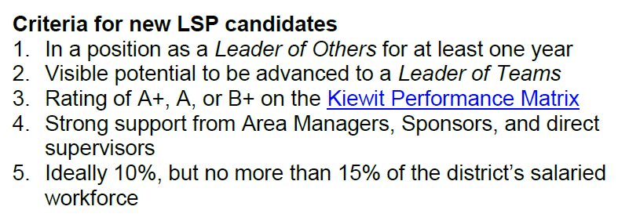
Building the LSP Roster
First Name | Last Name | Position Title | 9 Sq | Coach | Talent Pool | Ready | Pool #2 | Ready
David | Johnson | Supt | A | Gwyon Elson | PM1 | 2-3 yrs | PM2 | 3-4 yrs
Michael | Graham | Dep Const Mgr | A+ | Bill Smith | PP1 | 1-2 yrs | Sponsor | 2-3 yrs
Donald | Arant | Piping Supt | B+ | Ricardo Cummings | PM1 | 3-5 yrs | PM2
Bryan | Reese | Infra Supt. | A | Glenn Jones | PM1 | 3-5 yrs | PM2
Kent | Oberle | CivDesCoordMgr | A | Gwyon Elson | Sponsor | 0-12 mos
Andy | O'Keeffe | Supt 2 | A+ | Chuck Hucks | PM1 | 2-3 yrs | Sr PM | 2-3 yrs
Ronnie | Edmonds | Env Acc Util Supt | A | Bryan Randall | PM 2 | 2-3 yrs | Sponsor | 4-5 yrs

Slide 33
Assigning Coaches
First Name | Last Name | Position Title | 9 Sq | Coach | Talent Pool | Ready | Pool #2 | Ready
David | Johnson | Supt | A | Gwyon Elson | PM1 | 2-3 yrs | PM2 | 3-4 yrs
Michael | Graham | Dep Const Mgr | A+ | Bill Smith | PP1 | 1-2 yrs | Sponsor | 2-3 yrs
Donald | Arant | Piping Supt | B+ | Ricardo Cummings | PM1 | 3-5 yrs | PM2
Bryan | Reese | Infra Supt. | A | Glenn Jones | PM1 | 3-5 yrs | PM2
Kent | Oberle | CivDesCoordMgr | A | Gwyon Elson | Sponsor | 0-12 mos
Andy | O'Keeffe | Supt 2 | A+ | Chuck Hucks | PM1 | 2-3 yrs | Sr PM | 2-3 yrs
Ronnie | Edmonds | Env Acc Util Supt | A | Bryan Randall | PM 2 | 2-3 yrs | Sponsor | 4-5 yrs

Slide 34
Identifying Career Paths
First Name | Last Name | Position Title | 9 Sq | Coach | Talent Pool | Ready | Pool #2 | Ready
David | Johnson | Supt | A | Gwyon Elson | PM1 | 2-3 yrs | PM2 | 3-4 yrs
Michael | Graham | Dep Const Mgr | A+ | Bill Smith | PP1 | 1-2 yrs | Sponsor | 2-3 yrs
Donald | Arant | Piping Supt | B+ | Ricardo Cummings | PM1 | 3-5 yrs | PM2
Bryan | Reese | Infra Supt. | A | Glenn Jones | PM1 | 3-5 yrs | PM2
Kent | Oberle | CivDesCoordMgr | A | Gwyon Elson | Sponsor | 0-12 mos
Andy | O'Keeffe | Supt 2 | A+ | Chuck Hucks | PM1 | 2-3 yrs | Sr PM | 2-3 yrs
Ronnie | Edmonds | Env Acc Util Supt | A | Bryan Randall | PM 2 | 2-3 yrs | Sponsor | 4-5 yrs

Slide 35
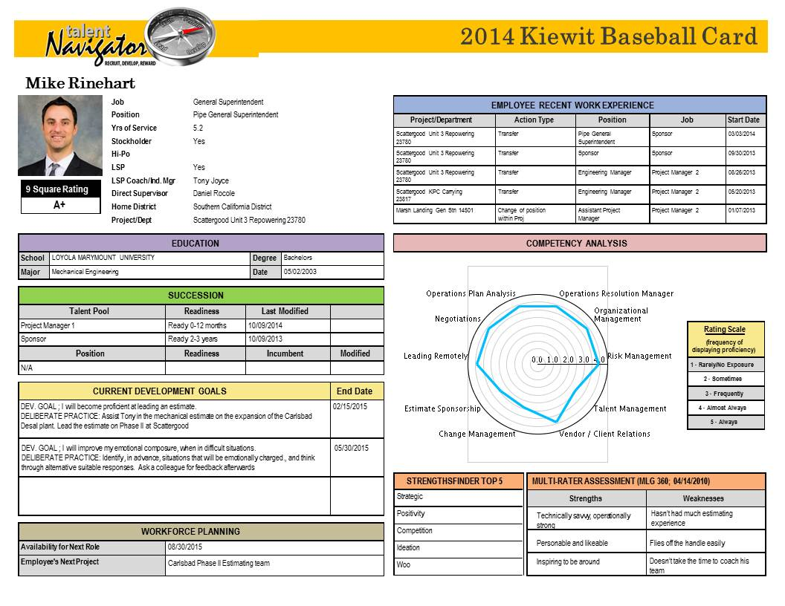

Slide 36
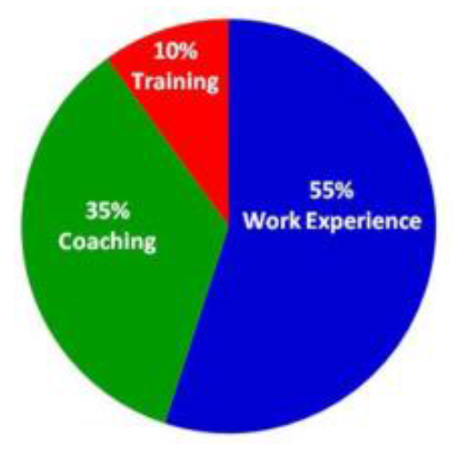
Developmental Philosophy

Slide 37
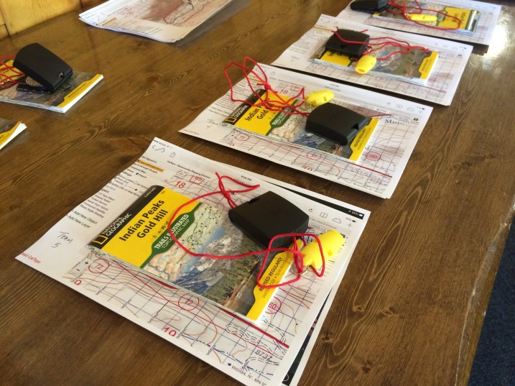
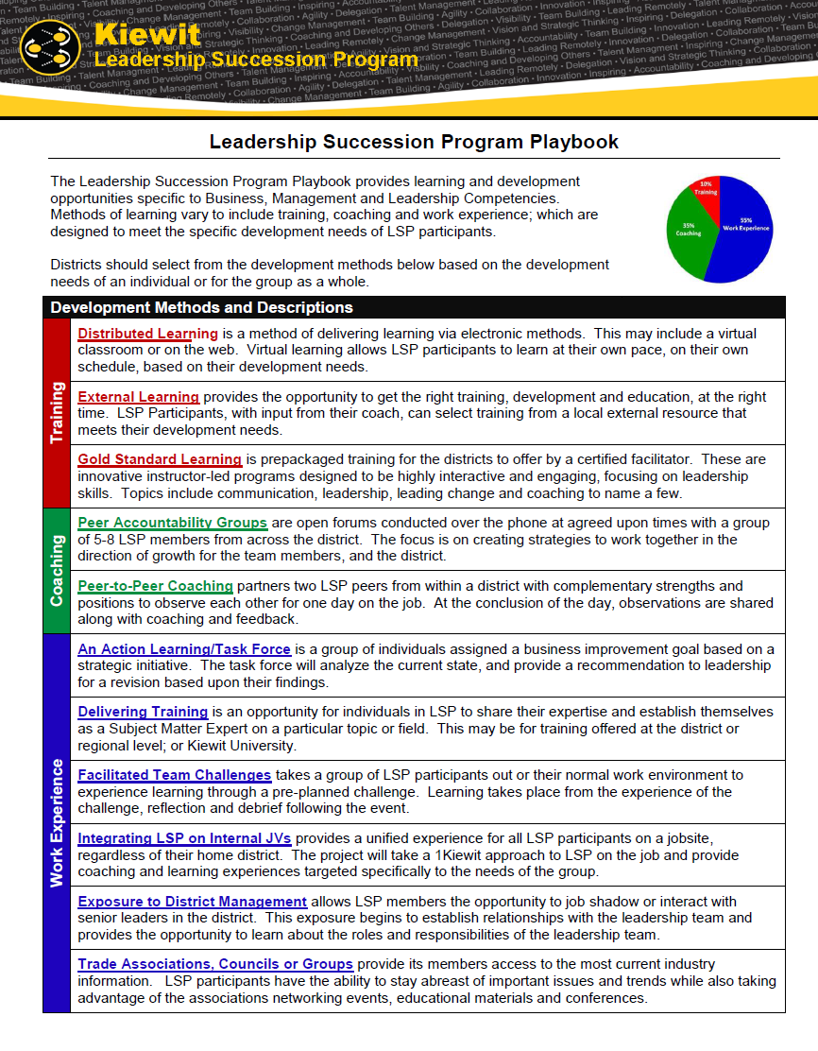
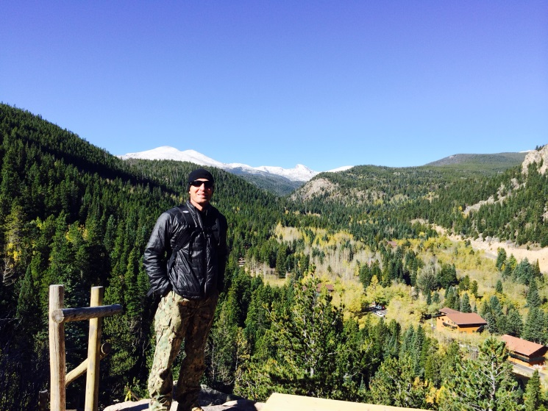
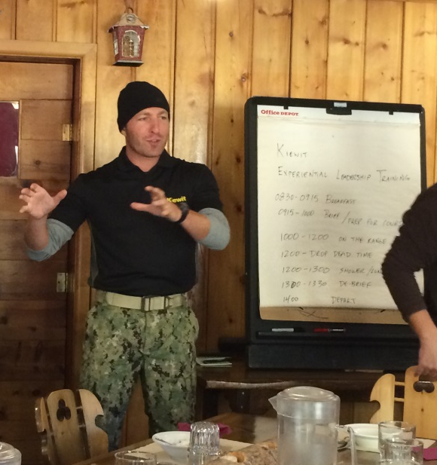
Developmental
Playbook

Slide 38

Building a
Developmental
Playbook

Slide 39
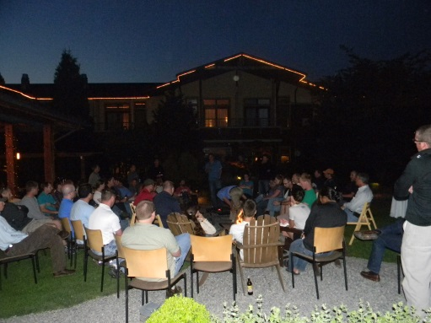
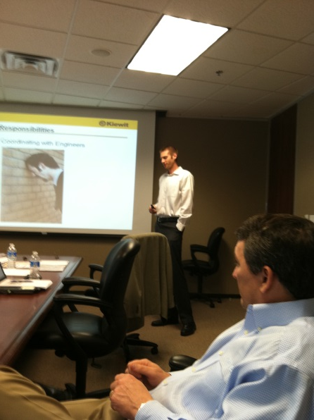
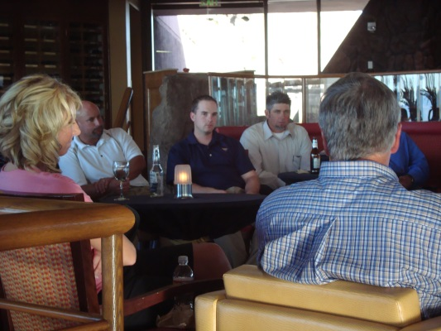
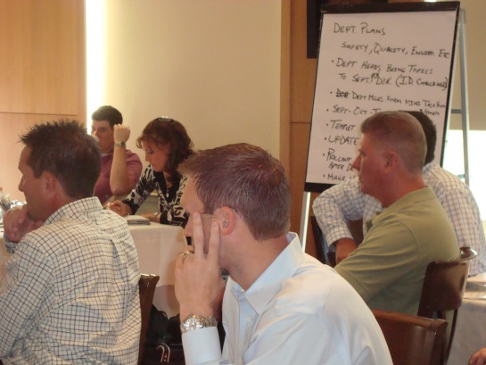
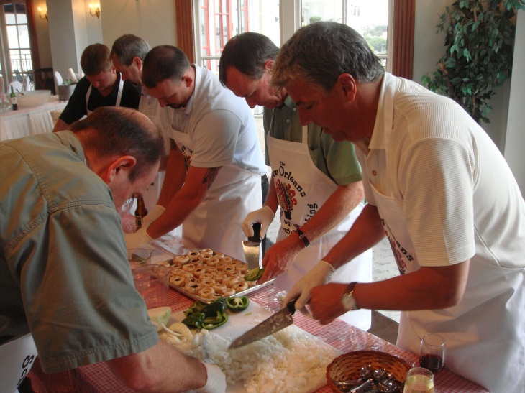
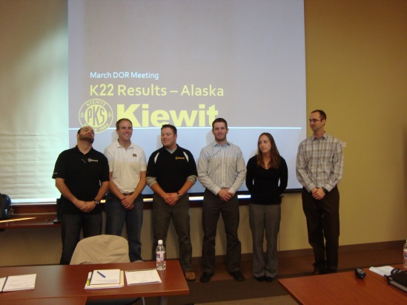
Building a
Developmental
Playbook

Slide 40
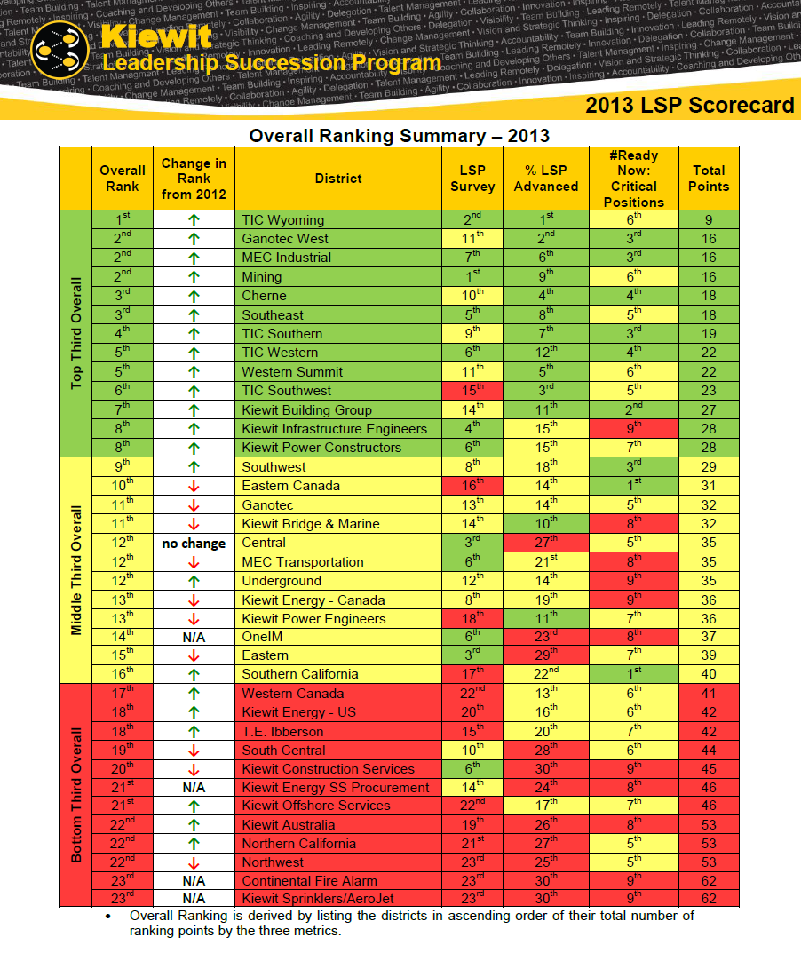

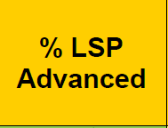

Measurement and
Competition

Slide 41
Measurement and
Competition

Slide 42
Identify and accelerate your high potentials
Provide role-specific development to everyone
ELDP
Dist/Div Manager Area Manager Mega Project Director BD Exec
Leader of an Organization
Hi Po
Sponsor School
Project Manager Sponsor Dept. Mgr.
Leader of Teams
Project Mgr School
LSP
Superintendent School
Job Supt, Supt Project Eng Area Safety Mgr Sr. Bus.Mgr
Leader of Others
Field Engineer School
Culture School
Estimator, Entry-level Business Manager etc.
Individual Contributor

Slide 43
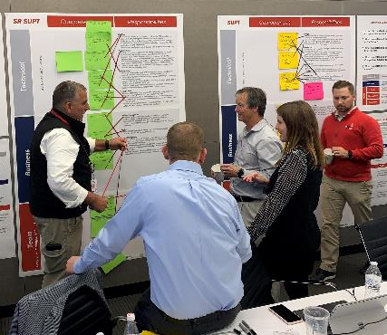
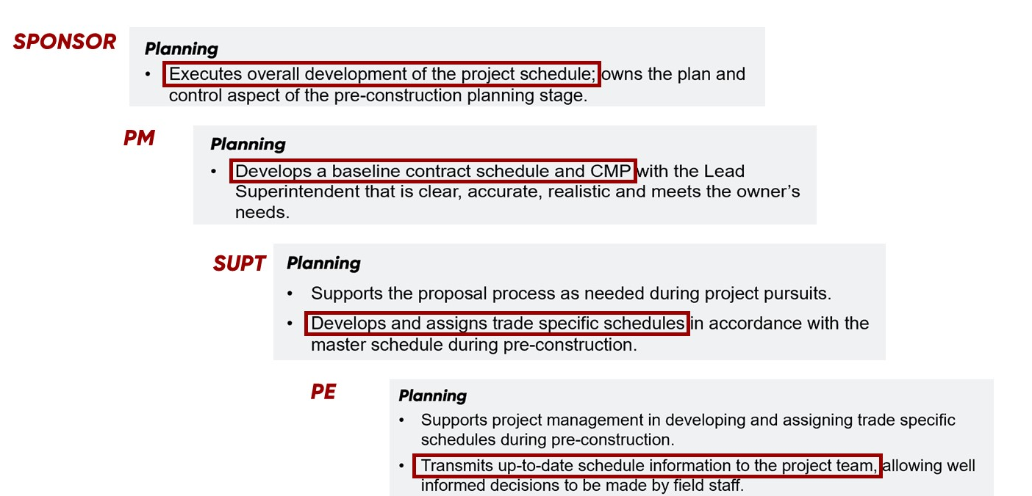
Roles and Responsibilities
Superintendent School

Slide 44
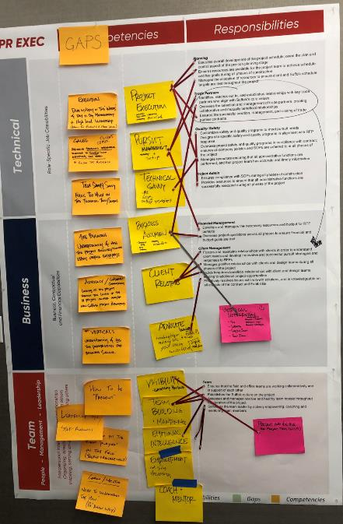
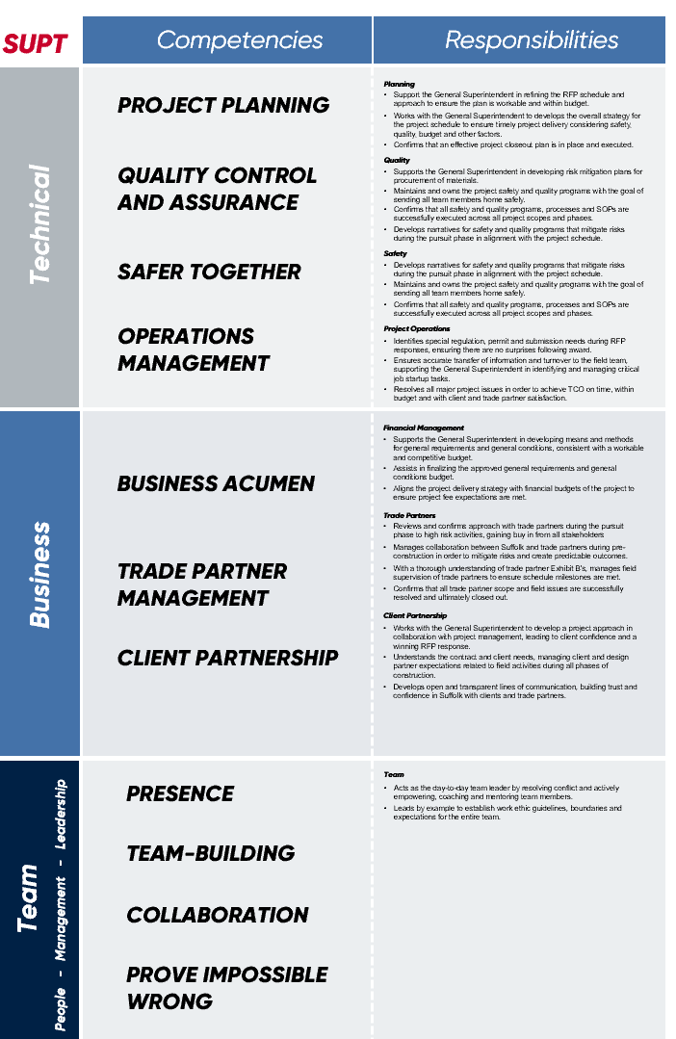
Roles and Responsibilities
Competencies
Superintendent School

Slide 45
Roles and Responsibilities
Competencies
Curriculum
Superintendent School

Slide 46
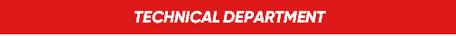
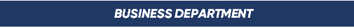
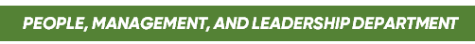
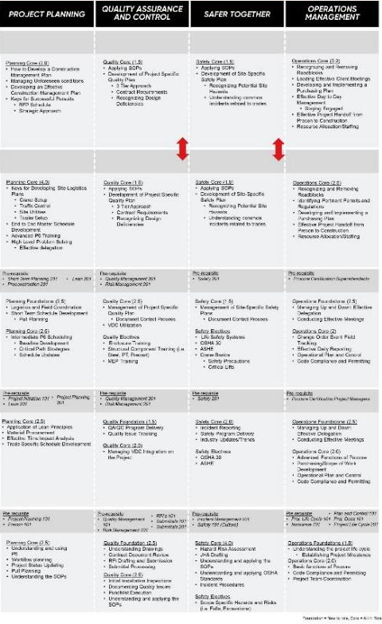
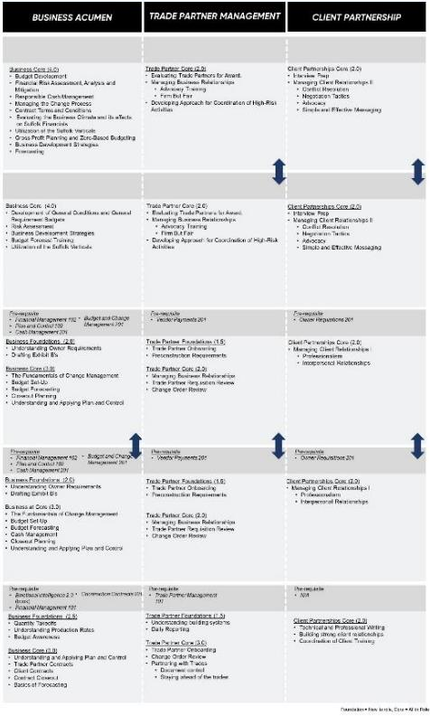
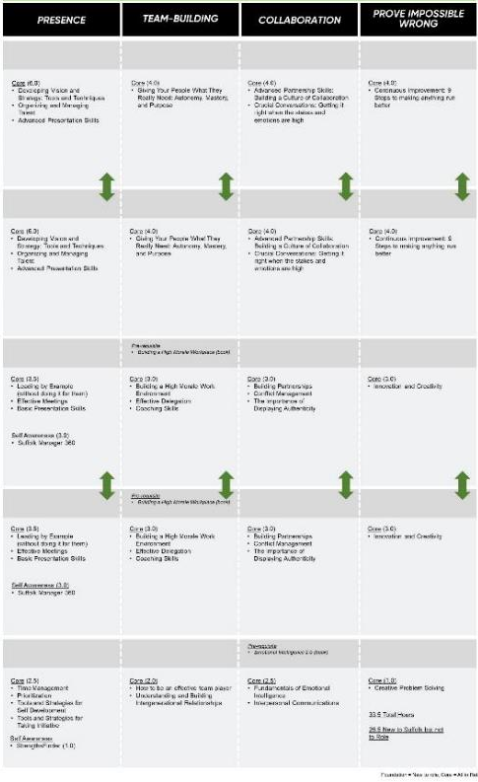
Curriculum
Departments

Slide 47
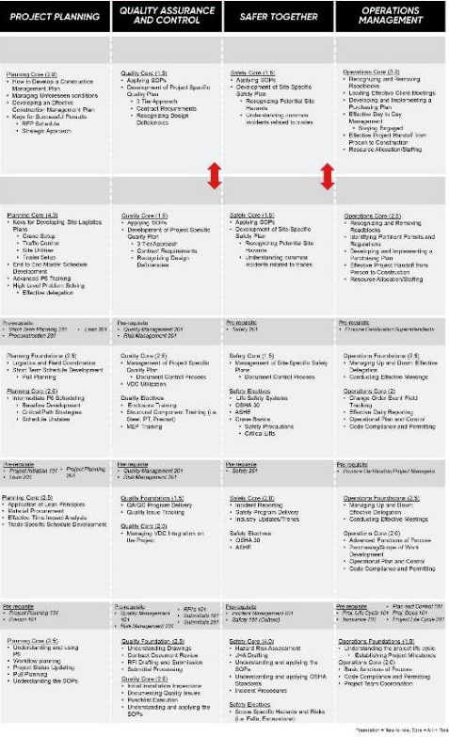
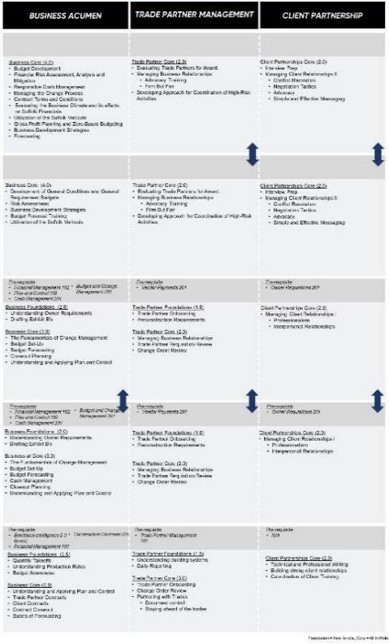
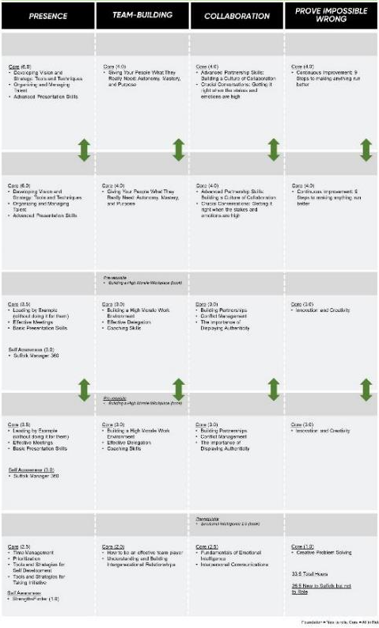
Curriculum
Competencies

Slide 48
Curriculum
Competencies

Slide 49
Suffolk
Academy
Curriculum
Schools

Slide 50
Curriculum
Schools
FIELD ENGINEER
SUPERINTENDENT
PROJECT MANAGER
SPONSOR
ELDP

Slide 51
Curriculum

Slide 52
Modules

Slide 53
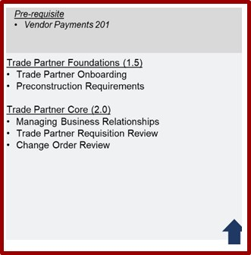
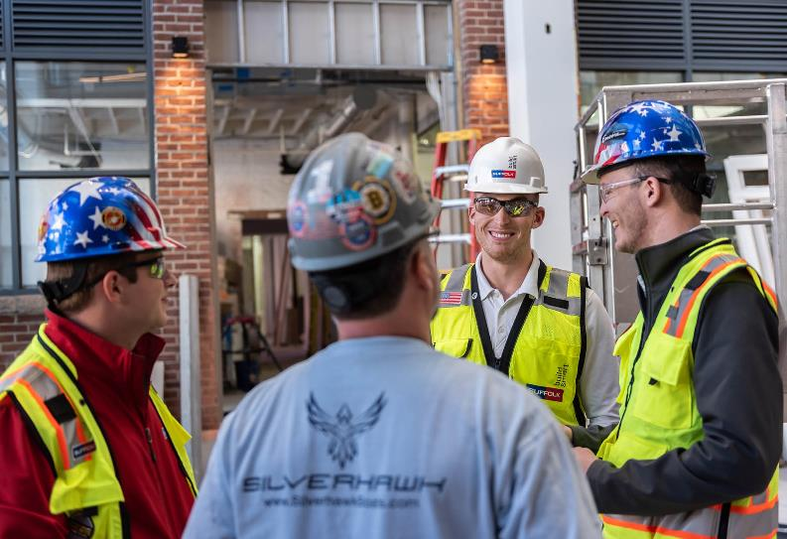
Notes:
To accomplish your vision, Suffolk will need an organization wide employee development program
Let me explain WHY
Growth from the Core: Expanding regionally and across sectors
Your greatest resource to accomplish that growth is People.
To attract the ‘right’ people, Suffolk will need to understand what competencies/capabilities are necessary to effectively perform the work
To retain people, you’ll need to invest in training your people to have the competencies necessary to effectively perform their work to increase engagement – highly engaged team members will demonstrate the capabilities through their behaviors and outcomes/results achieved
To account for your personnel with limited experience and retiring team members, Suffolk will need to develop a succession plan to ensure team members:
Have the capabilities/competencies to perform at the next level before being promoted,
Reduce the time it takes to be promoted
This is how you will win the ‘war for talent’
Business Systems
Embrace and implement technology/systems to accommodate growth
scale operational and functional processes with confidence.
To set a new standard; Suffolk needs to create a new standard to accelerate growth
t the core of Suffolk Business Systems is a systematic and replicable series of processes to ensure our growth and expansion is implemented in a thoughtful and planful manner. SBS will underpin every major process within the organization, allowing the company to scale operational and functional processes with confidence. Its implementation will alleviate stressors and deliver efficiencies company-wide and will set a new standard for how Suffolk operates, helping accelerate our pace of growth.
We’re in the midst of transformation in defining our 5-year plan – currently dubbed “Vision 2024”.
The one-minute elevator pitch for Vision 2024:
The core Suffolk Construction business is healthy, growing, and able to weather economic downturns - we could carry on quite happily and comfortably with business as usual. However, business as usual and the status quo are not enough. We have far bigger aspirations.
· We want to be compared to best-in-class companies. Not simply compared to contractors. Period.
· We’re bringing in talent from diverse industries and iconic brands.
· We’re continuing to expand geographically and into new sectors.
· We’re adding verticals to complement and leverage the core construction business.
· We align ourselves with the best of academics, technology providers and partners.
· We embrace technology and data in ways competitors don’t.
· We have the resources and potential to help solve major social & economic issues and improve communities in a meaningful way.
Key message: Given our entrenched position, relationships and strong success in the core construction business, we’re well-positioned to unleash the power of Suffolk Construction on new verticals to unlock more value from the broader value chain. We’re already growing the core Suffolk Construction business by expanding regionally and in sectors.
What’s new is expanding in Self-Perform, Suffolk Ventures, Suffolk Special Projects, Supply Chain, Suffolk Innovation, Suffolk Risk Management, and Suffolk Property & Facilities Management under a parent entity “Suffolk”.
Key message: This growth will be facilitated by “Suffolk Business Systems” (SBS), our new business management system in early stage development and roll out. At the core of Suffolk Business Systems is a systematic and replicable series of processes to ensure our growth and expansion is implemented in a thoughtful and planful manner. SBS will underpin every major process within the organization, allowing the company to scale operational and functional processes with confidence. Its implementation will alleviate stressors and deliver efficiencies company-wide and will set a new standard for how Suffolk operates, helping accelerate our pace of growth.
· The verticals are in various stages of maturity. They will not all be rolled out at the same time.
· While the new verticals (technology, investments, etc) are potentially sexier than Suffolk Construction, none of these entities exists – much less succeeds – without the foundation of a healthy core construction business.
The audience:
· We’re a company of very successful builders. 55% percent of our employees work in the field.
· We’re geographically dispersed in offices and job sites across the country.
· A large proportion of our employees won’t relate to expansion in the verticals. A proportion of them may be indifferent or concerned we’re drifting away from the “goose that lays the golden egg”.
· They may be skeptical of additional layers of process associated with Suffolk Business System – for fear of exposing lack of process and / or additional work and bureaucracy.
· 54% of our associates are Millennials – a technology-fluent demographic that relies heavily on mobile access and easily digestible information.
· We’re in a continual “war for talent” to attract, retain, and engage in-demand employees. Our most experienced field employees are also age-ing out of the system, with a significant percentage of field employees now with few years of experience.
· The leadership team is focused on improvement in our Employee Engagement Scores – employee dissatisfiers include work/life balance, flexibility and a desire for more transparent communications.

Slide 54
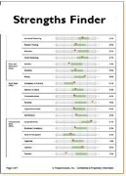
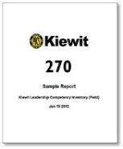

Identify and accelerate your high potentials
Provide role-specific development to everyone
Extra support at the transitions
ELDP
Dist/Div Manager Area Manager Mega Project Director BD Exec
Leader of an Organization
Transition #3
Leader of an Organization
Hi Po
Sponsor School
Project Manager Sponsor Dept. Mgr.
Leader of Teams
Transition #2
Leader of Teams
Project Mgr School
Superintendent School
Job Supt, Supt Project Eng Area Safety Mgr Sr. Bus.Mgr
Leader of Others
Transition #1
First Time Leader
Field Engineer School
Culture School
Estimator, Entry-level Business Manager etc.
Individual Contributor

Slide 55
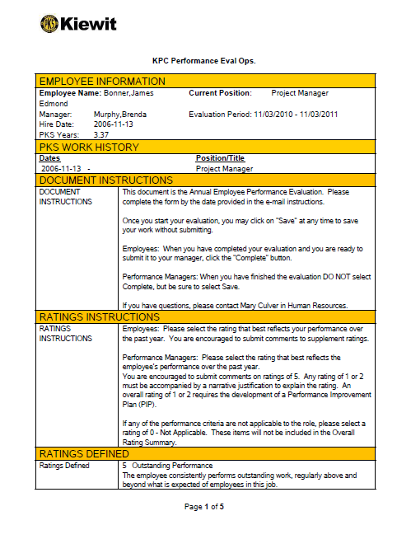
Identify and accelerate your high potentials
Provide role-specific development to everyone
Extra support at the transitions
Let them know how they’re really doing

Slide 56

Identify and accelerate your high potentials
Provide role-specific development to everyone
Extra support at the transitions
Let them know how they’re really doing
How you are performing
What you need to work on
Where you are going
How can I help you get there?

Slide 57


One Page Annual Interview

Slide 58

5 Year Results
Average years to advance

Slide 59
2002
2006
2007
Total new
needed in 5 yrs
Headcount
Project Managers | 230
Reduced time to advance = 14 to 9 yrs.
# Years with Company

Slide 60
5 Year Results

Slide 61
Histogram of Kiewit Experience
(District Salaried)
We’re keeping more of our people
# of Employees
Kiewit Years

Slide 62







Slide 63

What have you learned that you can use?

Slide 64

Kiewit Intern
Verrazano Narrows Bridge
New York City

