Slide 1
What is the SoDak SHRM State Council…
And What Does SoDak SHRM Do?

Slide 2
SoDak SHRM State Council?
Vision
To be the premier organization in South Dakota for the professional development and advancement of Human Resources.
Mission
Lead Human Resources in South Dakota through:
Human Resource expertise
Advocacy
Professional support
Educational Opportunities
Networking

Slide 3
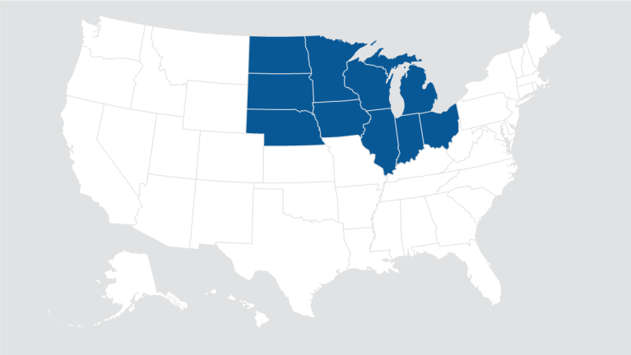
What is the SoDak SHRM State Council?
Like all state councils, the SoDak SHRM State Council is an autonomous entity that operates as an affiliate of SHRM. Each state council conducts the affairs of a nonprofit organization under the general guidance of SHRM. The SoDak SHRM State Council is responsible directly to the North Central Region

Slide 4
What is the SoDak SHRM State Council’s role ?
To provide a forum for chapters to discuss common issues, problems, concerns and to share ideas and successes;
To facilitate information from chapters and the state council to the area and national boards and from the area and national boards to the state council and chapters;

Slide 5
What is the SoDak SHRM State Council’s role?
To represent SHRM by visiting and communicating with chapters and promoting and sharing with members the services and benefits offered by SHRM;
To assess the needs of members and chapters, and meeting those needs by securing and /or providing information; To adopt programs that will promote the progress, visibility, and welfare of SHRM and its members in the human resource profession; and coordinate state and national legislative affairs.

Slide 7
Who is the SoDak SHRM State Council?
Director – Laurie Gates, SHRM-CP, PHR
Director Elect – Tammy Loos, SHRM-CP, PHR
Past Director – Sheila Mennenga, SHRM-SCP, SPHR
Certification Director – Mary Drumm
Legislative Director – Julie Johnson
Secretary – Bobbie Falk
Treasurer – Sheila Mennenga
Technology Director – Jessica DeYoung
Workforce Readiness Director – Kim Ludwig
State Conference Director – Cindy Krekelberg
College Relations Director – Heidi Schooley
Diversity Director – Tammie Krumm
Marketing - Jessica DeYoung
Membership – Jillaine Pfeifle
Professional Development – Peter Berger
Interested in serving the SoDak SHRM State Council?
Contact Laurie Gates, lgates@escomfg.com

Slide 8
National SHRM
South Dakota Society for
Human Resource Management
Aberdeen Area Human Resource Association
Black Hills SHRM
Brookings Area Human Resource Management
Central SD SHRM
Northeast SHRM
Sioux Empire SHRM
Southeast SD SHRM
How does each chapter fit in?
Each of our 7 affiliate chapters are part of SoDak SHRM, and National SHRM.

Slide 10
SHRM Resources:
MAC Representative
Jeremy York, SHRM-SCP, SPHR Lead Consultant and President
InvigorateHR Jeremy@invigoratehr.com
SHRM Staff
Faith Stipanovich, SHRM-SCP Field Services Director Central faith.Stipanovich@shrm.org
Member Engagement Associate Central shrm.memberrelations@shrm.org

Slide 11
Who is SoDak SHRM? It’s all of us!
By being a member of your chapter, you are automatically a member of SoDak SHRM!
For more information please contact us or go to the SoDak SHRM State Council Website:
http://www.sodakshrm.org/

